Slide 1
Introductory General Chemistry
Chemistry 3A
Experiment 11a
Synthesis of Alum
Mitch Halloran

Slide 2
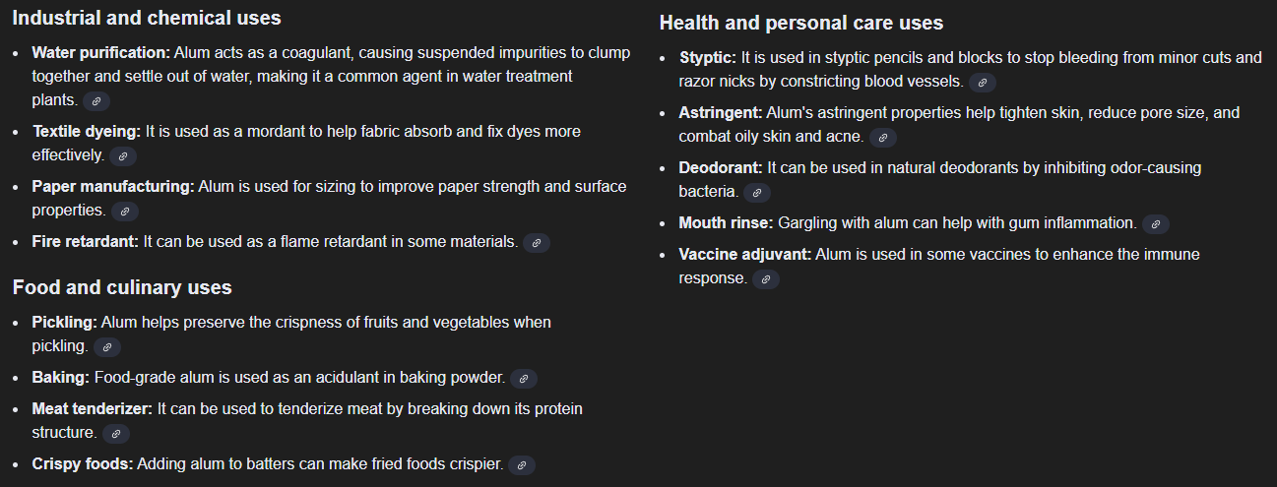
Introduction
This experiment will produce potassium aluminum sulfate dodecahydrate [KAl(SO₄)₂ • 12 H₂O]—called alum from aluminum metal
Alum uses and purposes are numerous

Slide 3
Background
There are FOUR reactions involved in alum synthesis:
2 Al (s) + 2 KOH (aq) + 6 H₂O (l) →
2 KAl(OH)₄ (aq) + 3 H₂ (g)
SINGLE REPLACEMENT – REDOX – This reaction evolves a gas
2 KAl(OH)₄ (aq) + H₂SO₄ (aq) →
2 Al(OH)₃ (s) + K₂SO₄ (aq) + 2 H₂O (l)
DOUBLE REPLACEMENT – PRECIPITATION – This is a precipitation
2 Al(OH)₃ (s) + 3 H₂SO₄ (aq) → Al₂(SO₄)₃ (aq) + 6 H₂O (l)
This is an ACID-BASE NEUTRALIZATION of an alkaline precipitate
Al₂(SO₄)₃ (aq) + K₂SO₄ (aq) + 24 H₂O (l) →
2 KAl(SO₄)₂ • 12 H₂O (s)
This is a HYDRATION & CRYSTALLIZATION of a double salt
2 Al (s) + 2 KOH (aq) + 4 H₂SO₄ (aq) + 22 H₂O (l) →
2 KAl(SO₄)₂ • 12 H₂O (s) + 3 H₂ (g)
This is the NET REACTION by combining all steps

Slide 4
Background
In these reactions, the product of one step is carried over as a reactant in the succeeding step
Many reaction types are involved, from a gas-evolving step to a precipitation to an acid-base neutralization and then to a crystallization of a double salt
A double salt is where a compound involves a combination or mixture of two metal cations, in this case potassium (K) and aluminum (Al) both countered with a sulfate anion (SO₄)
There are many steps to pay careful attention to their execution

Slide 5
Reproducibility
Instruments of all kinds do not always give a true reading just one time in use
Careful scientists will often want to get a mass on a balance not just once, but even THREE times to ensure reproducibility
Check the web page I wrote in ensuring reproducibility in use of instruments
http://fresno.chem101.com/Chemistry/BetterLabReports.html

Slide 6
Limiting & Excess Reagents
You will use three reagents in this experiment
  aluminum solid (foil or powder)
  potassium hydroxide
  sulfuric acid
Which of these is/are the limiting reagent? Can there be more than one limiting reagent?
Which of these is/are the excess reagent? Can there be more than one excess reagent?
About 0.4 g aluminum is used. What is that in moles?
Why was about 20 mL of 1.5 M KOH used?
Why was 7.5 mL of 6 M sulfuric acid used?

Slide 7
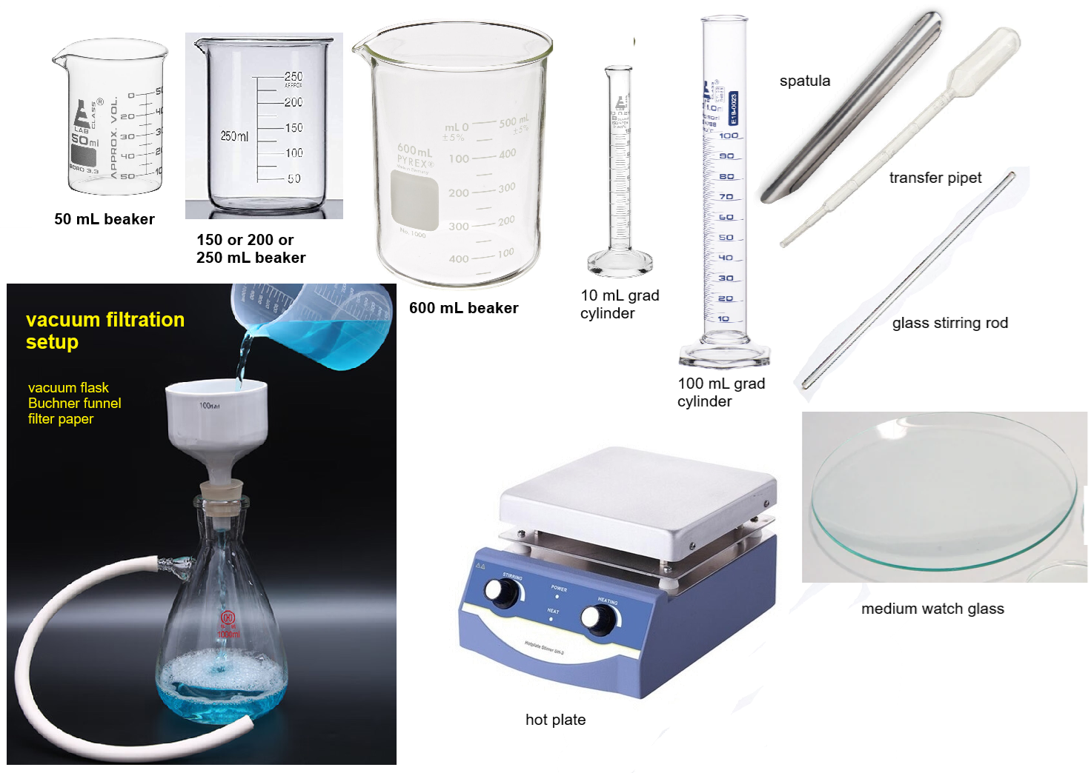
Equipment You Will Use

Slide 8
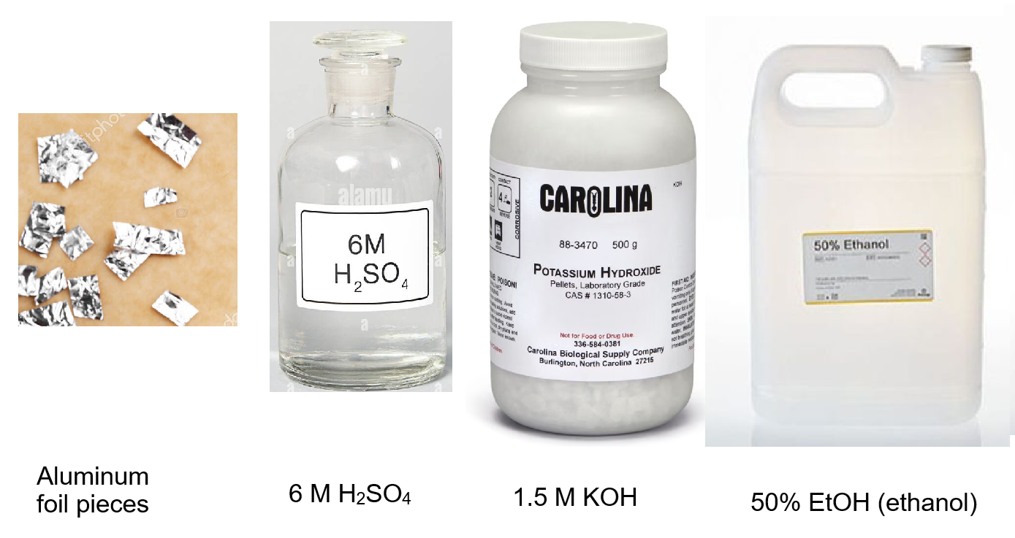
Consumables You Will Use

Slide 9
Procedure
Select a 150, 200, or 250 mL beaker and record its mass
Tear about 0.4 g aluminum foil into small pieces and place in beaker
Record the mass of beaker with foil pieces
Put name on the beaker with Sharpie
Reaction 1 - REDOX (H₂ Gas Evolution) (Step 5)
  In the fume hood, add 20 mL of 1.5 M KOH to the beaker
  The foil pieces should dissolve and the solution becomes black. It takes about 20 min for reaction to be complete
  While reaction occurs, start calculating theoretical yield
  If reaction slows, put beaker on a hot plate but be prepared to take beaker off the hot plate so it does not boil!
  Is there a gas produced? What is it?

Slide 10
Procedure
Reaction 2 (Precipitation) [DD]
Into a 50 mL beaker, pour 7.5 mL of 6.0 M H₂SO₄ from a 10 mL graduated cylinder
While stirring the dissolved aluminum solution with a glass rod in the larger beaker, use a transfer pipet to transfer the acid solution to the aluminum solution DROPWISE. Make sure you stir well after each drop. Look for a greyish white precipitate
Reaction 3 (Acid-Base Neutralization)
Cover beaker with watch glass and warm solution on hot plate until the precipitate has dissolved. Be careful NOT to get it to hot and boil the solution!!
After full dissolution, let beaker cool for few minutes

Slide 11
Procedure
Into a larger beaker set up an ice-water bath
Place the reaction beaker in the ice-water bath and let it sit for 15 min
Reaction 4 (Hydration-Crystallization)
Swirl beaker when crystal formation is noticed. If after 5 min crystals are not seen, scratch inside of beaker with glass rod to induce nucleation
Into a separate small beaker, pour 30 mL of 50% ethanol and place in ice-water bath

Slide 12
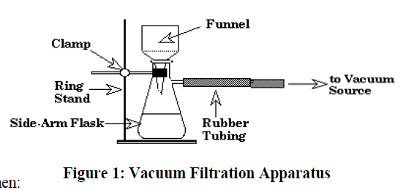
Procedure
Set up a vacuum filtration apparatus as shown
  Apply the vacuum to the apparatus and wet the filter paper so that it adheres to funnel bottom with all the holes covered
  Swirl the beaker to loosen crystals and pour the crystals with solution on to the paper in the funnel
  Pour ~10 mL of cold 50% EtOH into beaker and then swirl to wash out crystals into funnel while also slowly washing the crystals with the ethanol through the filter paper. Repeat ethanol washing of crystals

Slide 13
Procedure
  After washing is complete, let the crystals remain on the vacuum until they appear dried by the process. Prodding the crystals with a glass rod should prove how dry they are
Record the mass of a clean & dry watch glass
Transfer the crystals to the watch glass. Now record the mass of the crystals + watch glass
Determine the yield of crystals and use to complete rest of report

Slide 14
Clean Up
Except only for glass containers that had reaction mixture, just a brief water rinse of glassware and upside-down drip-drying on a sink rack pin is sufficient; this includes grad cylinders & beakers getting KOH and H₂SO₄
A small amount of soap on brush wash should be sufficient
There is a solid waste beaker to receive under fume hood near doors
Any liquid waste there is a large carboy also in that fume hood
Clean up area as usual. Quick paper towel dry wipe is enough to dry.

Slide 15
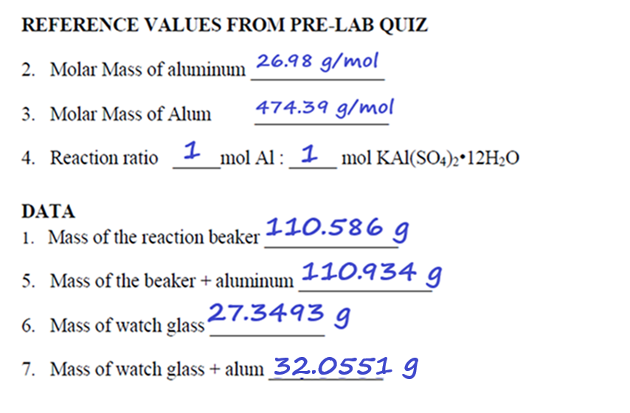
Example Data Analysis

Slide 16
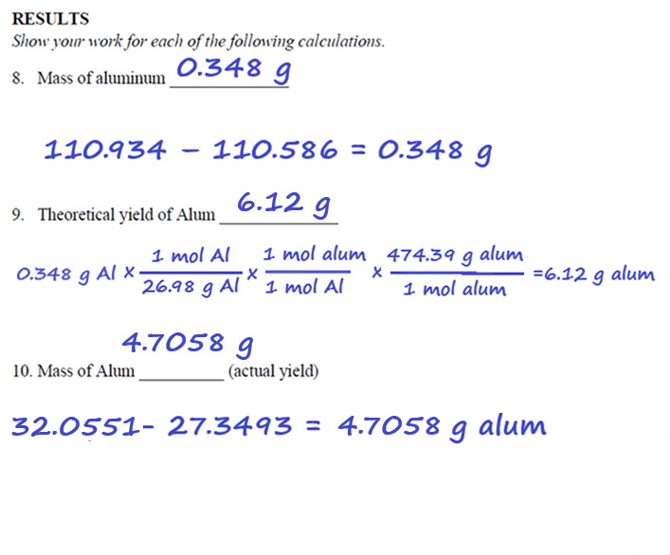
Example Data Analysis

Slide 17
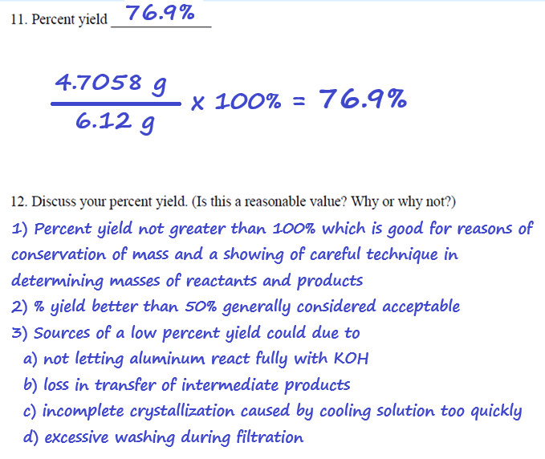
Example Data Analysis

Slide 18
Analyzing Excess Reagent Use
Here is overall reaction in alum synthesis
2 Al (s) + 2 KOH (aq) + 4 H₂SO₄ (aq) + 22 H₂O (l) →
2 KAl(SO₄)₂ • 12 H₂O (s) + 3 H₂ (g)
If we use 0.4 g Al foil: 0.400 g/26.98 g/mol = 0.0148 mol Al
20 mL of 1.5 M KOH is used: = 0.020 L*1.5 M = 0.030 mol KOH
KOH is double the amount of aluminum as an excess reagent (more than twice)

